Slide 1
DAA HACKATHON | PROBLEM #32
School Bus Route Planner
Smart pickup routes that respect road distance, bus capacity and student priority.
Name : T.Sai Hansika
Problem Domain: Transportation & Logistics / Smart Education
Core Algorithms: Dijkstra • BFS • Greedy

Slide 2
The Challenge
2 / 7
Real-World Problem
Why It Matters
Key Challenges
Schools plan bus routes by hand or guesswork
Many stops, uneven roads, limited seats
Each bus must still reach school on time
Shorter rides: safer, less tiring for children
Lower fuel cost and fewer buses needed
Fair pickup for students with higher priority
Find true shortest road distance between stops
Never exceed bus capacity
Balance distance against pickup priority
Detect unreachable stops early

Slide 3
Our Innovation
3 / 7
Core Idea: Use real shortest-path distances (Dijkstra) as the cost, then let a priority-aware Greedy rule build capacity-safe routes – and explain every decision.
Priority-aware
Capacity-safe
Explainable
Reachability check
Stops scored by distance and pickup priority
Bus is never overloaded
Shows why each stop was chosen
BFS flags isolated stops first
Unique approach: combines three DAA techniques in one pipeline instead of a single shortest-path run.

Slide 4
How It Works
4 / 7
INPUT
PROCESSING
ALGORITHM
OUTPUT
Stops, road map, distances, bus capacity, priorities
Build weighted graph; BFS checks reachability
Dijkstra distances + Greedy stop selection
Route per bus, total distance, load, reasons
User Journey
1. Add stops & school
2. Set capacity & priorities
3. Click "Plan Routes"
4. View route + explanation

Slide 5
Technology & Algorithm
5 / 7
Tech Stack
Python
Algorithms
Algorithm | Role | Why chosen | Complexity
Dijkstra | Shortest road distance between stops | Road weights are non-negative | O((V+E) log V)
BFS | Reachability & minimum-hop check | Fast, flags unreachable stops | O(V+E)
Greedy | Pick next stop by distance + priority within capacity | Quick, explainable choices | O(n log n)
Flask
REST API
React
Route UI
PostgreSQL
Stops & routes

Slide 6
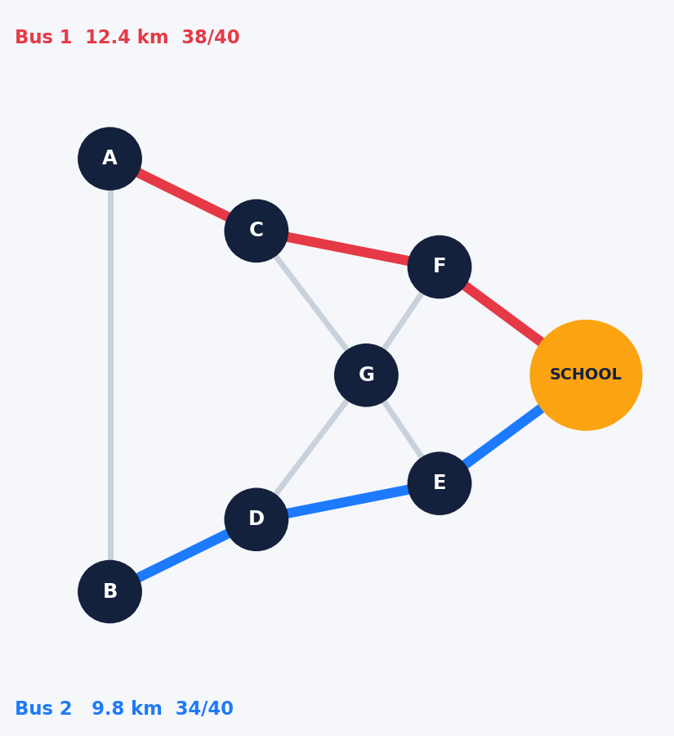
Demo & Impact
6 / 7
Sample Output
Results & Benefits
Bus 1: School ← A → C → F
Distance: 12.4 km | Load: 38/40
Bus 2: School ← B → D → E
Distance: 9.8 km | Load: 34/40
Reason: C chosen – nearest, high priority
Optimal road distances
Zero capacity violations
Unreachable stops flagged
Transparent for staff & parents
Sample illustration shown

Slide 7

Future Vision
7 / 7
Achieved
Future Work
Scalability
Dijkstra + BFS + Greedy pipeline
Capacity & priority aware
Explainable routes
Live traffic weights
Time-window pickups
Multi-school support
Heap-based Dijkstra
Cached distance matrix
Cloud-hosted API
Takeaway: Safer, shorter, fairer school commutes through smart algorithms.
Thank You | Q & A

